Slide 1

ENDOCRINE SYSTEM

Slide 2
DOT POINTS COVERED
the hypothalamus, pituitary, thyroid, parathyroid, pancreas, thymus, gonads, pineal and adrenal glands, are endocrine glands found in the human body
hormones secreted from the hypothalamus, pituitary, thyroid, parathyroid, pancreas and adrenal glands are involved in homeostasis by affecting specific target organs
the secretions of the pituitary gland are controlled by the hypothalamus through transport of hormones, either via nerve cells or the vascular link between them
hormones can be lipid-soluble and able to cross cell membranes to bind with and activate intracellular receptors or, water-soluble and able to bind with and activate receptors on cell membranes, and require secondary messengers to affect cell functioning

Slide 3
GLANDS
Two types of glands found in human body
Exocrine glands-secrete into duct that carries waste outside of body
Endocrine glands- secrete hormones into extracellular fluid around gland. Passes into capillaries and travels around body through bloodstream

Slide 4
Hormones
Secretions of endocrine glands- HORMONES
Classified into
Amine
Protein
Steroid
Cells can communicate through releasing hormones (paracrines)

Slide 5
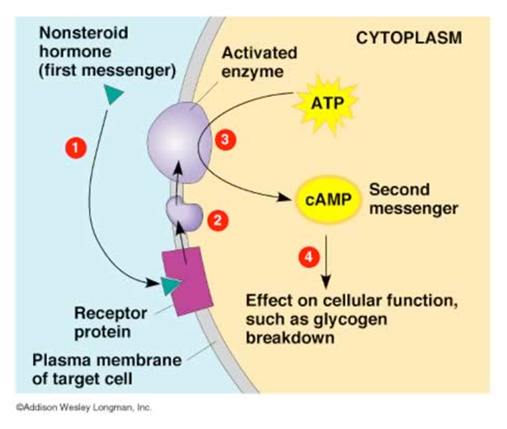
Protein/Amine Hormones
Proteins and amines are polar, This makes them insoluble in substances like lipids. (insoluble to cell membrane)
Work through attaching to receptor proteins in the membrane of target cell.
Combination (Hormone-receptor complex) causes second messenger to diffuse through cell to affect targeted enzymes

Slide 6
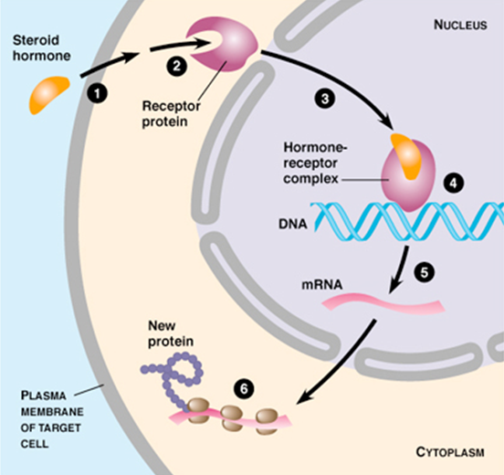
Steroids
Are soluble in lipids of cell membrane
Can enter cell by diffusion
Bind with receptor on mitochondria/other organelles or on the nucleolus
Activates genes for the production of specific proteins or enzymes

Slide 7
HORMONES
Change functioning of cell through changing type activities or quantites of proteins produces- not enzymes
Hormones can
Activate certain genes in the nucleous to manufacture particular protiens
Change the shape or structure of an enzyme (turn on or off)
Change rate of production of an enzyme through affection transcription and translation

Slide 8
HORMONE FUNCTION
ENZYME AMPLIFICATION
One hormone affects more than one enzyme molecule- cascading domino affect-small stimulus=large response
HORMONE CLEARANCE
After producing affect- needs to be cleared. Broken down in host cell or liver and kidneys-excreted through urea or bile

Slide 9
TYPES OF HORMONES
 | Amines and Proteins | Steroids
Solubility | Soluble in water (polar) | Insoluble in water (non-polar, lipid soluble)
Membrane Permeability | Cannot pass through the membrane | Diffuse through the phospholipid bilayer
Receptors | Located on the outside of the cell membrane (need a secondary messenger inside the cell) Use receptor proteins embedded in the membrane | Intracellular receptors that may be on the mitochondria, other organelles or within the nucleus
Action | Causes changes in cell metabolism: Membrane permeability Activate enzymes Cause protein synthesis | Cause changes in gene expression: Cause proteins to be synthesized by expressing genes on DNA Epigenetics
Can be stored | Yes | No – made on demand
Examples | Any hormone not made by these glands → Epinephrine Thyroxin Oxytocin | All hormones made by the gonads and adrenal cortex: Testosterone Oestrogen Progesterone Aldosterone

Slide 10
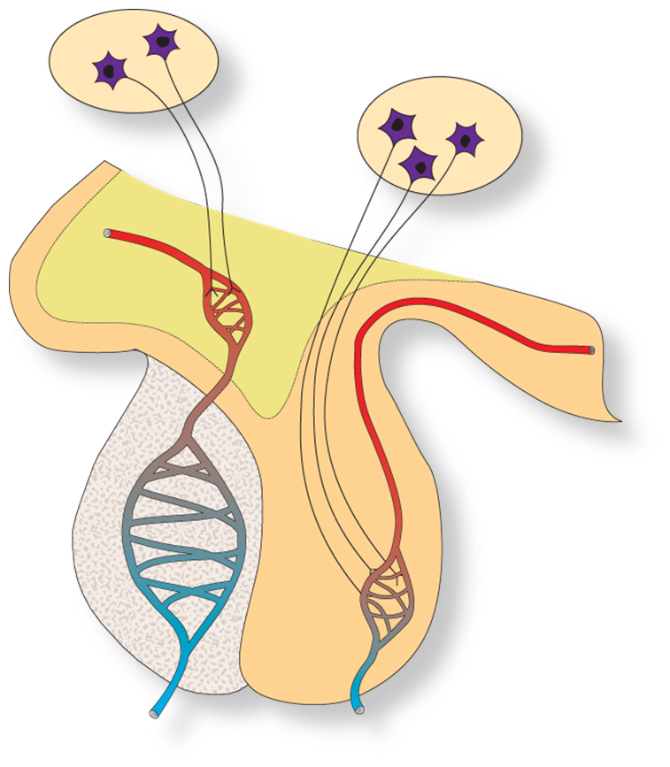
HYPOTHALAMS AND PITUITARY
Hypothalamus-base of brain
Regulates; body temp/water balance/heart rate
Many functions controlled through pituitary gland
Pituitary gland
Lies under hypothalamus and joined by talk called infundibulum
Vital for normal body function

Slide 11
ANTERIOR LOBE OF PITUITARY
HORMONE | TARGET ORGAN | MAIN EFFECTS
Follicle-stimulating hormone (FSH) | Ovaries (Female) Testes (Male) | Growth of follicles Production of sperm
Luteinising hormone (LH) | Ovaries (Female) Testes (Male) | Ovulation and maintenance of corpus luteum Secretion of testosterone
Growth hormone (GH) | All Cells | Growth and protein synthesis
Thyroid-stimulating hormone | Thyroid gland | Secretion of hormones form the thyroid
Adrenocorticotropic hormone (ACTH) | Adrenal cortex | Secretion of hormones from the adrenal cortex
Prolactin (PRL) | Mammary glands | Milk production

Slide 12
POSTERIOR LOBE OF PITUITARY
Releases two hormones
Neither is manufactured in the posterior lobe
Both produces in nerve cells of hypothalamus
Moves down and is stored for release in posterior lobe
HORMONE | TARGET CELL | MAIN EFFECTS
Antidiuretic Hormone (ADH) | Kidneys | Reabsorption of water
Oxytocin (OT) | Uterus Mammary glands | Contractions during childbirth Release of milk

Slide 13
PINEAL GLAND
Found deep inside brain
1
Largest when younger-decreases in size with age
2
Secretes hormone-melatonin
3
Melatonin-sleep regulation
4

Slide 14
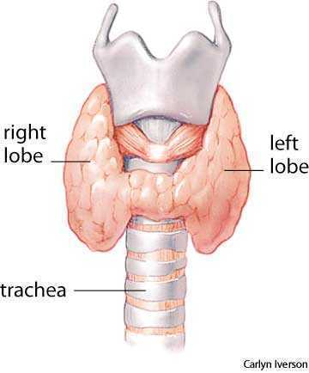
THYROID GLAND
Location-neck just below larynx
Structure-two lobes that lie either side of trachea
Hormone secretion-Thyroxine
Thyroxine-made from iodine and is an amino acid. Controls body metabolism

Slide 15
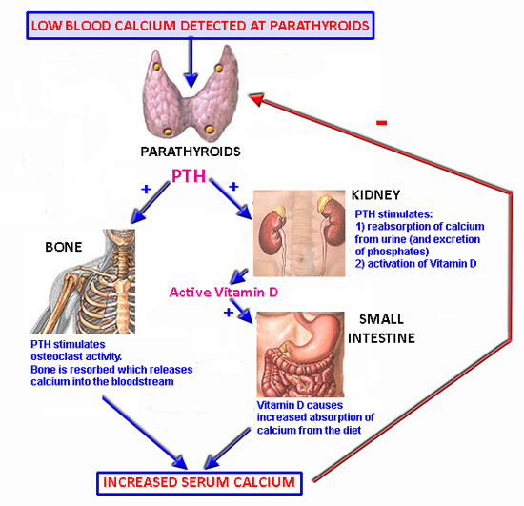
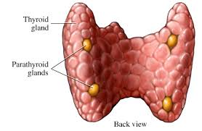
PARATHYROID GLANDS
Location-Embedded in the rear surface of thyroid
Structure- 4. Small pea sized
Hormone release-parathyroid hormone (PTH)-controls calcium and phosphate levels in the blood

Slide 16
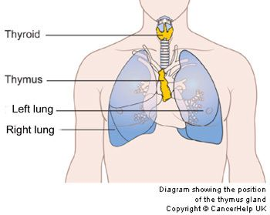
THE THYMUS
Location-in chest just above heart and behind sternum
Structure-largest when young. Shrinks after puberty
Hormone released-Group of hormones called thymosin's
Thymosin's-influence maturation of T-lymphocytes

Slide 17
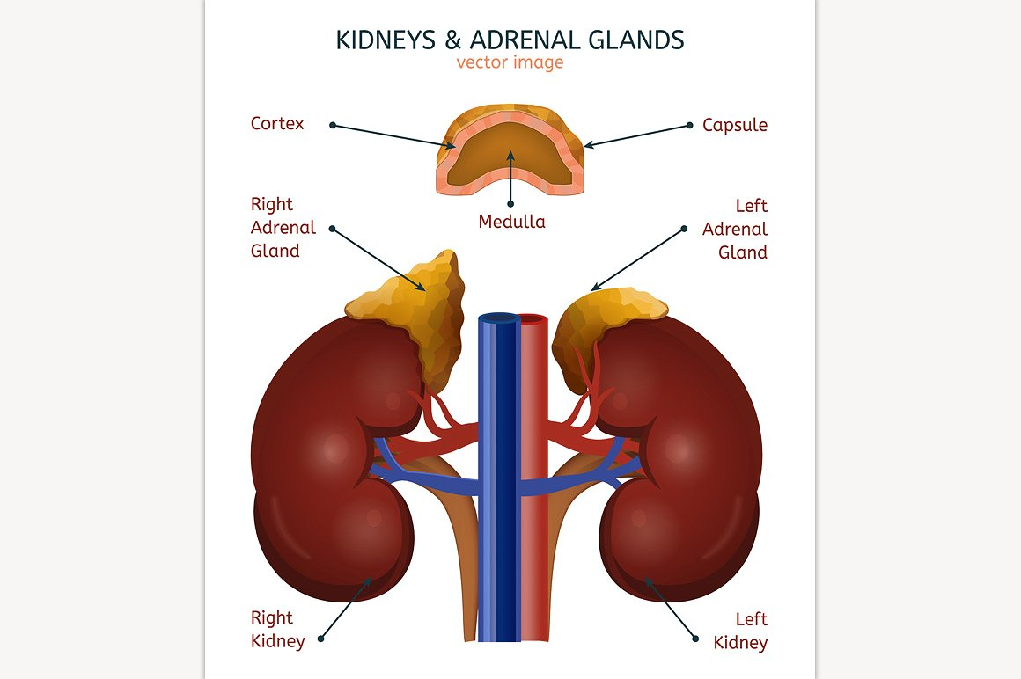
THE ADRENAL GLANDS
Two Adrenal glands
One immediately above kidney
Each adrenal gland has inner adrenal medulla and outer adrenal cortex
Different in structure and function
Thus two separate glands

Slide 18
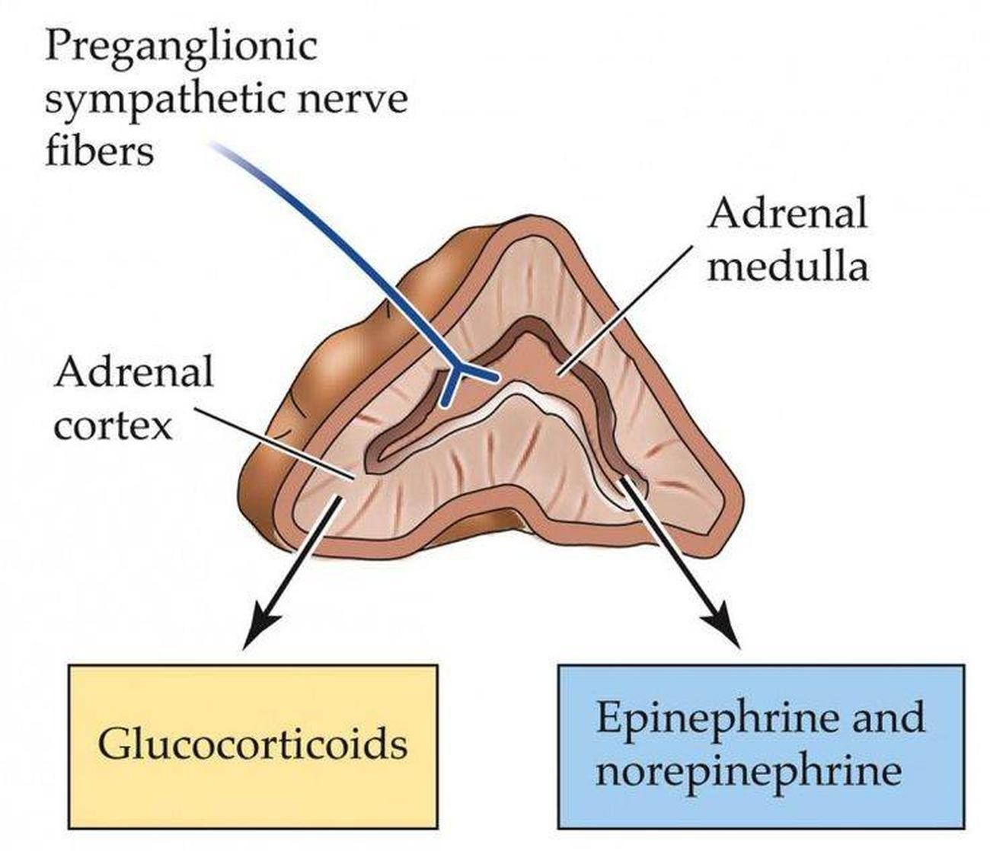
ADRENAL MEDULLA
Location-inside adrenal cortex-directly above kidney
Structure-inner portion of adrenal gland
Hormone released-Adrenaline and noradrenaline
Adrenaline-prepares body for fight/flight response. Reinforces the effects of sympathetic nervous system

Slide 19
ADRENAL CORTEX
Location-directly above kidneys
Structure-Outside layer of adrenal gland
Hormone released-group of more than 20 (corticosteroids)
Two main
Aldosterone-acts on kidney- Sodium decrease Potassium increase (amount in urine)
Cortisol-promotes normal metabolism-stress managment

Slide 20
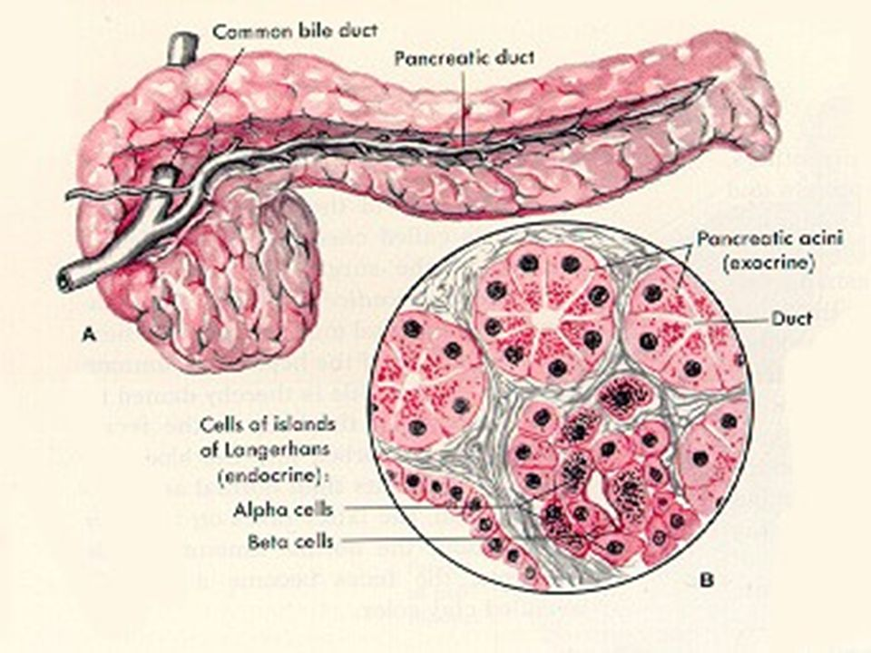
THE PANCREAS
Location-just below stomach and alongside the duodenum
Both exocrine and endocrine gland. Endocrine part is cluster of cells known as islets of Langerhans
Hormones produced
Glucagon-opposite to insulin. Breakdown of glycogen and fat
Insulin- uptake of glucose into cells

Slide 21
THE GONADS
Testes and ovaries
Produce sperm and eggs as well as hormones
Hormones released-Androgens, Oestrogens and progesterone
Androgens-male sex hormone. Development and maintenance of male sex characteristics
Oestrogens/progesterone-female sex hormones. Also regulate menstrual cycle. Involved in changes during pregnancy

Slide 22
GLAND | HORMONE | TARGET CELLS | MAIN EFFECTS
Thyroid | Thyroxine | Most cells | Increases body metabolic rate
Parathyroid | Parathyroid hormone | Bones Kidneys | Increases levels of calcium in blood
Thymus | Thymosins | T-lymphocytes | Stimulates maturation of T cells
Adrenal cortex | Corticosteroids Aldosterone Cortisol | Kidney Most cells | Increase reabsorption of sodium and excretion of potassium ions Promotes normal metabolism
Adrenal medulla | Adrenaline and noradrenaline | Most tissues | Prepares body for fight or flight response
Pancreas | Insulin Glucagon | Most cells Liver and fat storage | Stimulates uptake of glucose into cells Breakdown of glycogen and fat
Testes | Androgens | Many tissues | Sperm production. Male sex characteristics
Ovaries | Oestrogens Progesterone | Many tissues Uterus and mammary glands | Female sex characteristics. Regulate menstrual cycle Menstrual cycle and pregnancy prepares mammary glands for milk production

